Slide 1

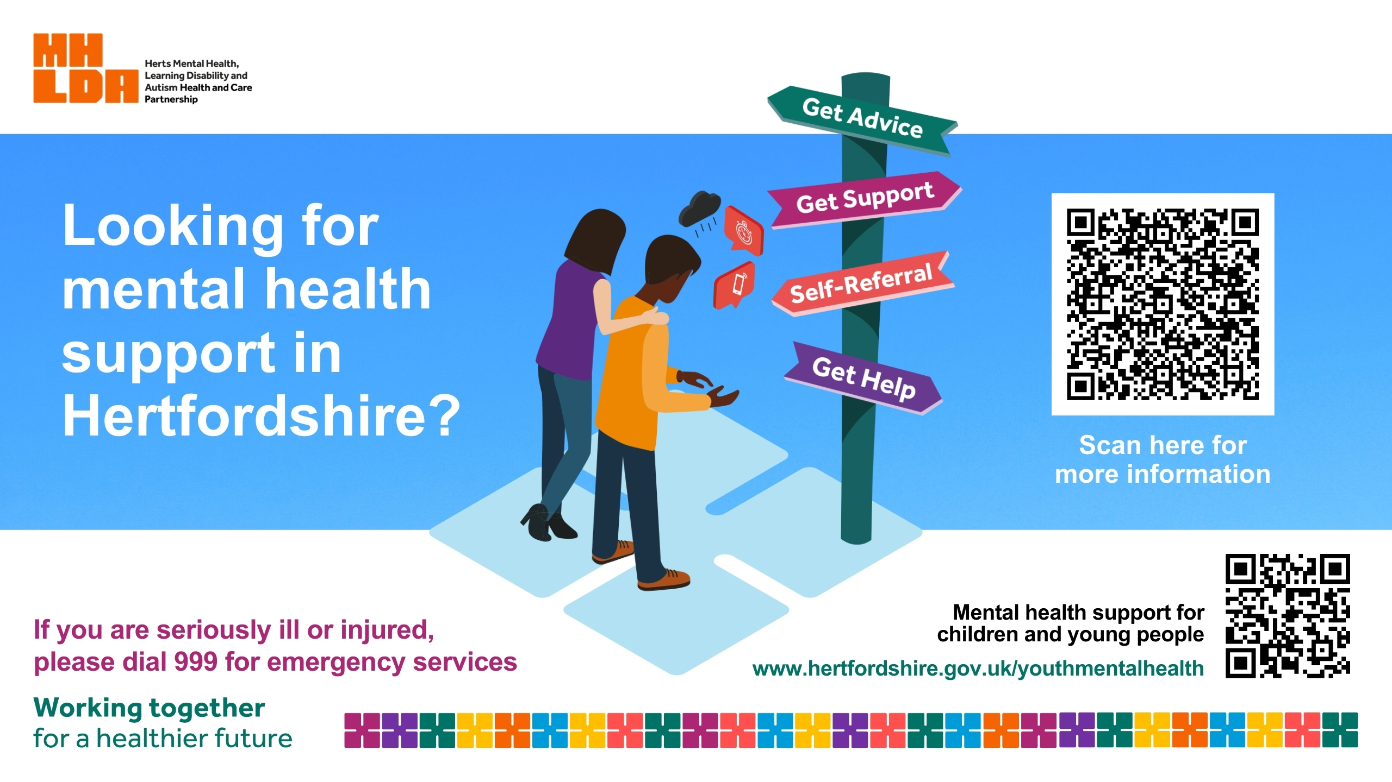
Winter Crisis Care Campaign – public messaging
Facebook | X/Insta | Image | Screensavers
You are not alone. If you or someone you care for finds themselves in crisis and in need of advice, support, or help, there is someone providing care and support in your community waiting for your call. Click here to learn more about the services that are located near to you that offer the care you need. Or You are not alone. There are care providers who are easy to access who don’t require a referral from your GP. Click here to learn more about these services and how to access them. | You are not alone. Care and support is available in your community. Click here to learn more about the services that are located near to you that may offer the care you need. Or You are not alone. There are providers of care in your neighbourhood or online who don’t require a referral from your GP. Click here to learn more about these services and how to access them.
Suggested tags: #mentalhealth #mentalhealthmatters #MHLDA Other suggested tags: Herts Mind Network, Mind in Mid Herts, Herts Help, HPFT, Viewpoint, Togetherall, NHS Talking Therapies | Suggested tags: #mentalhealth #mentalhealthmatters #MHLDA Other suggested tags: Herts Mind Network, Mind in Mid Herts, Herts Help, HPFT, Viewpoint, Togetherall, NHS Talking Therapies | There are a series of 9 images that have been created. Each image can be used as appropriate for your organisation. | There are two screensavers which can be used as appropriate for your organisation.

